Slide 1
Meteorological Data

Slide 2
Many inland people travel to mountain villages or cities close to the sea, in order to enjoy a little refreshment and get away from the sultry weather of the inland cities. This has always made me wonder what effect the proximity of the sea has on the climate.
This simple question can be a good starting point for data analysis. I don’t want to pass this chapter off as something scientific; it’s just a way for someone passionate about data analysis to put knowledge into practice in order to answer this question—what influence, if any, does the proximity of the sea have on local climate?

Slide 3
The System in the Study: The Adriatic Sea and the Po Valley
First you need a sea. Well, I’m in Italy and I have many seas to choose from, since Italy is a peninsula surrounded by seas. Why limit myself to Italy? Well, the problem involves a behavior typical of the Italians, that is, they take refuge in places close to the sea during the summer to avoid the heat of the hinterland. Not knowing if this behavior is the same for people of other nations, I will only consider Italy as a system of study. But what areas of Italy might we consider studying? Can we assess the effects of the sea at various distances? This creates a lot of problems. In fact, Italy is rich in mountainous areas and doesn’t have a lot territory that uniformly extends for many kilometers inland. So, to assess the effects of the sea, I exclude the mountains, as they may introduce many other factors that also affect climate, such as altitude, for example.

Slide 4
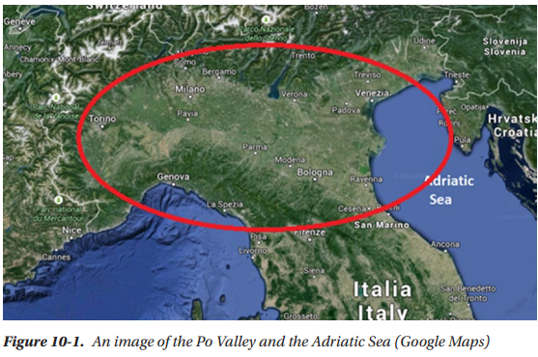
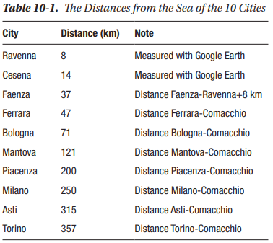
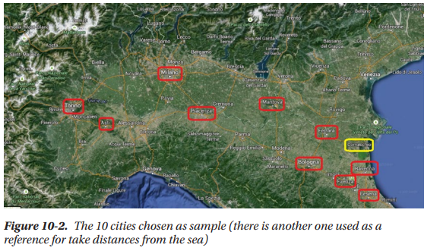


Slide 5
Cleaned or modified
The purpose of this analysis of the initial structure is to identify the data that could be most important in the JSON structure. These data must be processed for analysis. That is, the data must be extracted from the structure, cleaned or modified according to our needs, and ordered within a dataframe. This way, you can then apply all the data analysis techniques presented. A convenient way to avoid repeating the same code is to insert some extraction procedures into a function, such as the following.
«def prepare(city,city_name)»

Slide 6
Important Values
Among all the parameters described in the JSON structure within the list column, here are the ones most appropriate for the study.
• Temperature
• Humidity
• Pressure
• Description
• Wind speed
• Wind degree
you can see that each row shows the measured values for each hour of the day, covering a timeline of about 20 hours in the past.(on codes)

Slide 7
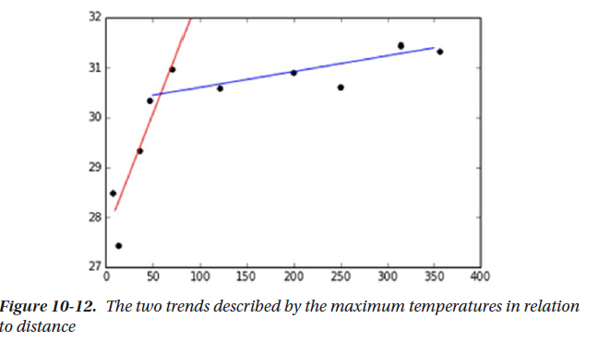

Slide 8
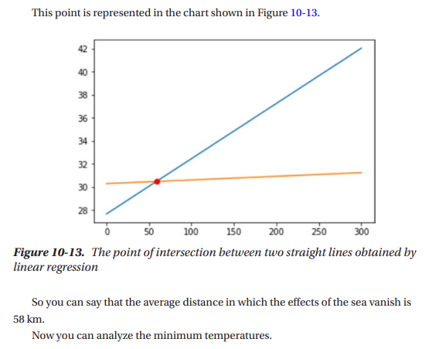

Slide 9
Resource
http://openweathermap.org/
http://api.openweathermap.org/data/2.5/weather?q=Atlanta,US&appid=5807ad2a45eb6bf4e81d137dafe74e15

